Slide 1
Library system
Abel Negash
Maheder Abreha
Yodit Abraha

Slide 2
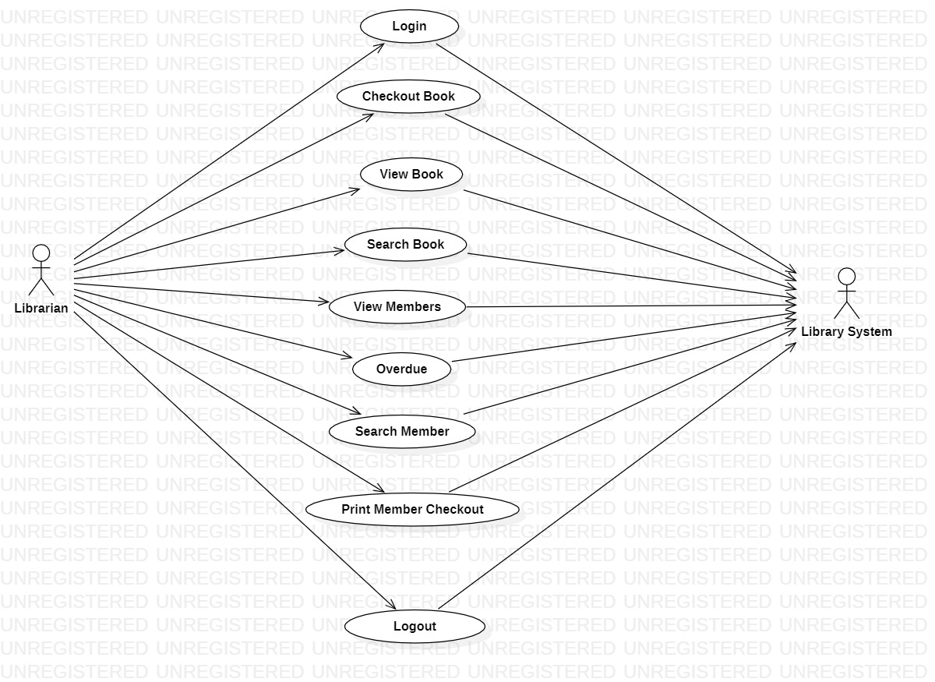
Use cases

Slide 3
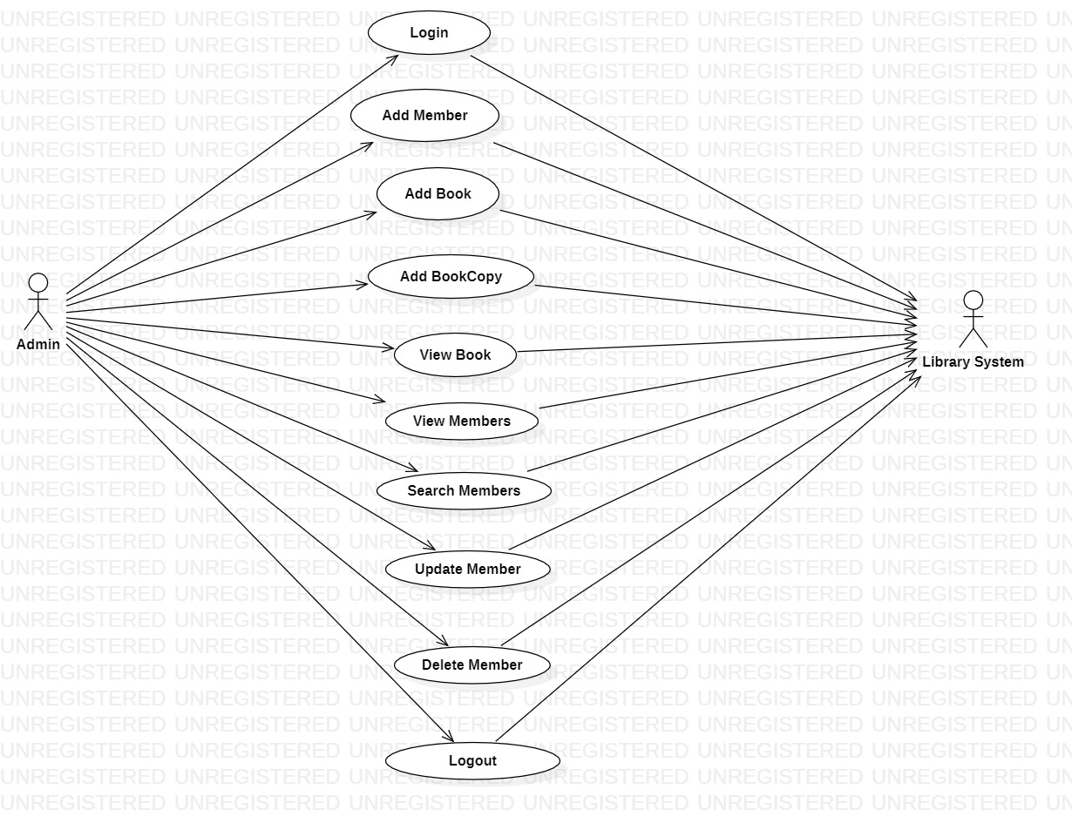

Slide 4
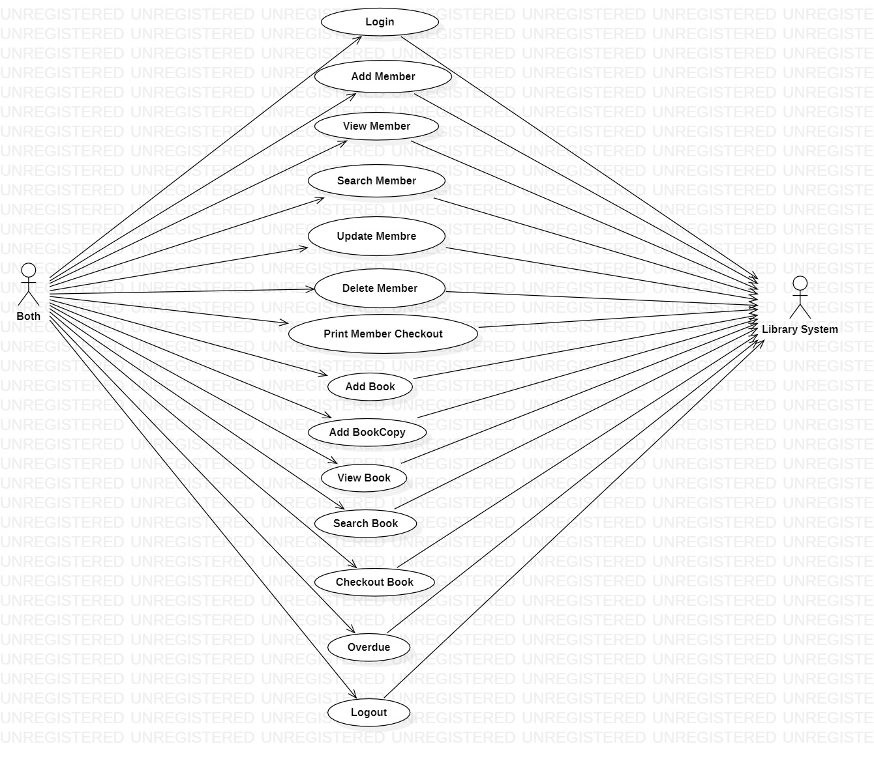

Slide 5
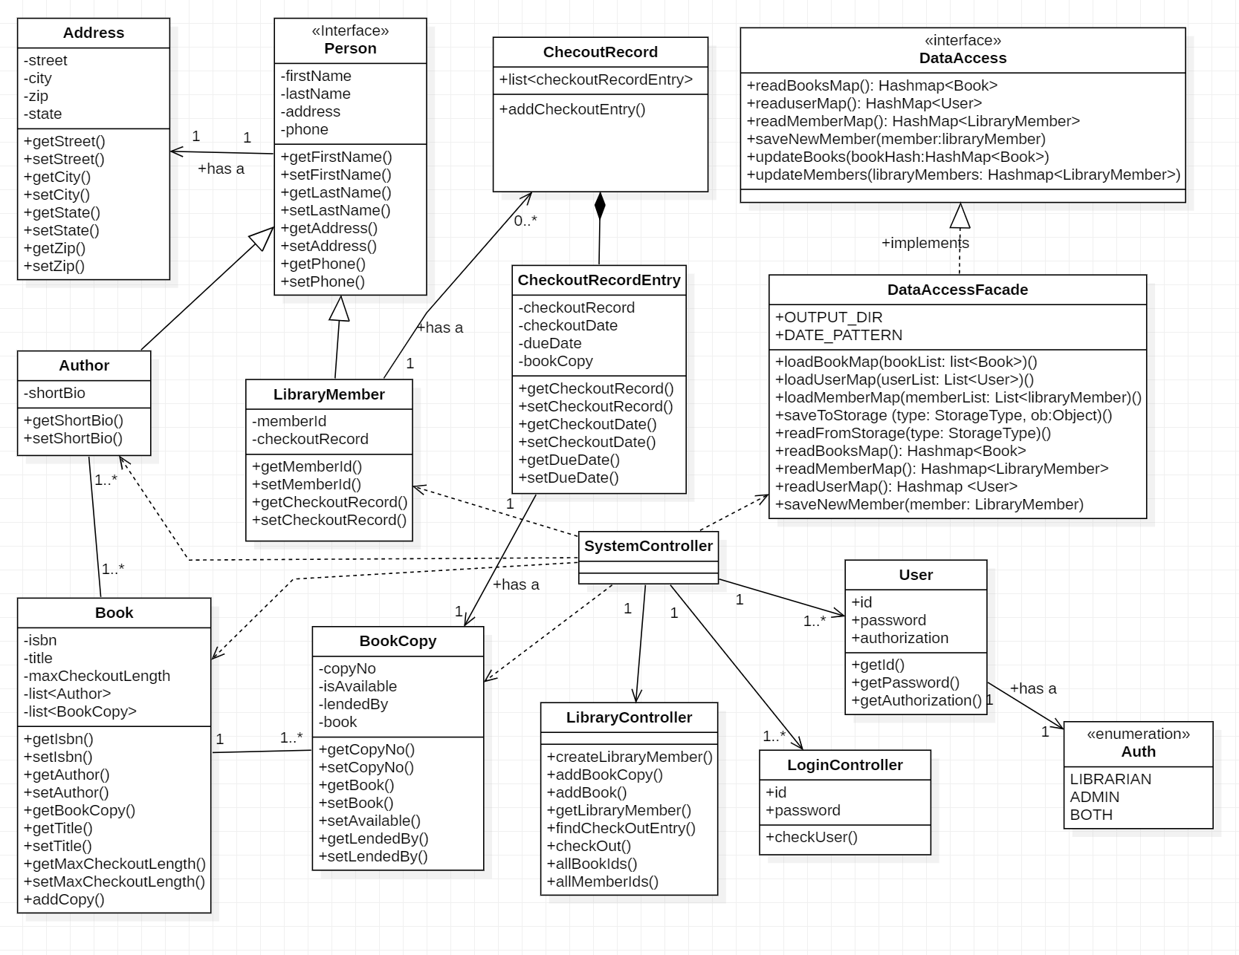
Class diagram

Slide 6
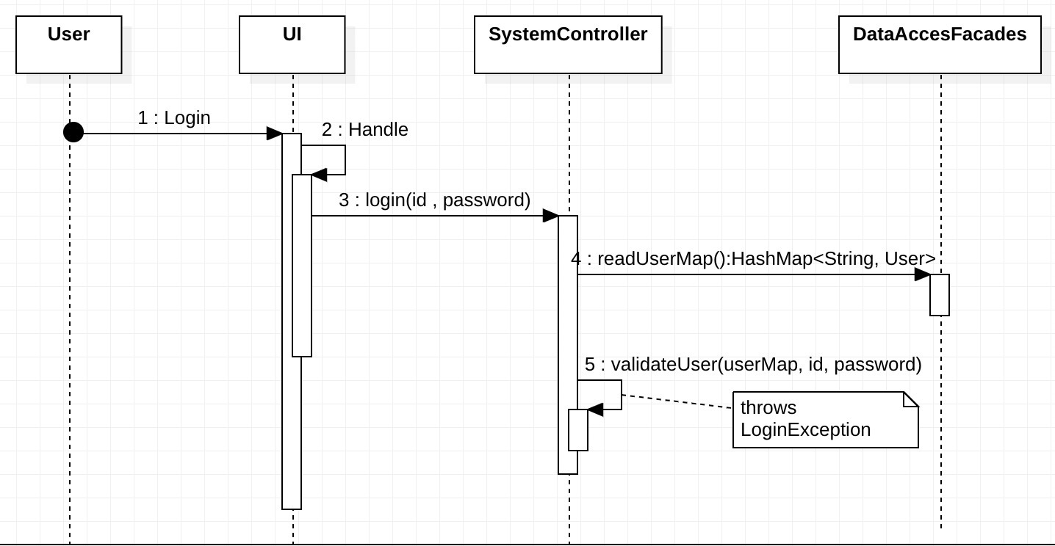
Sequence diagram Login

Slide 7
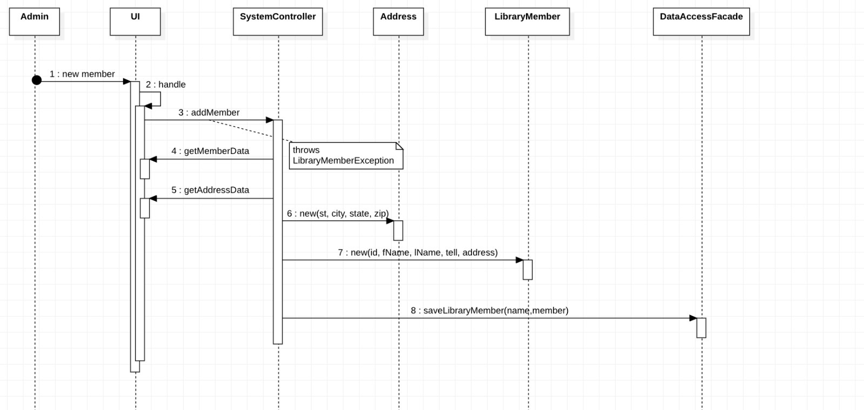
Add member

Slide 8
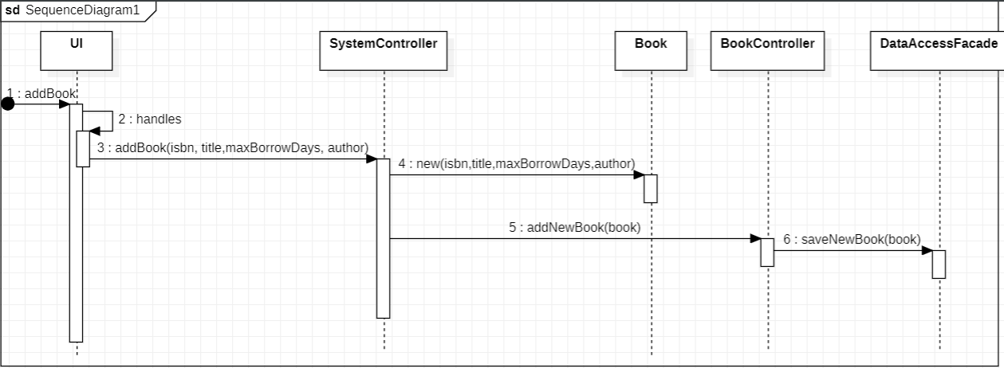
Add a new book

Slide 9
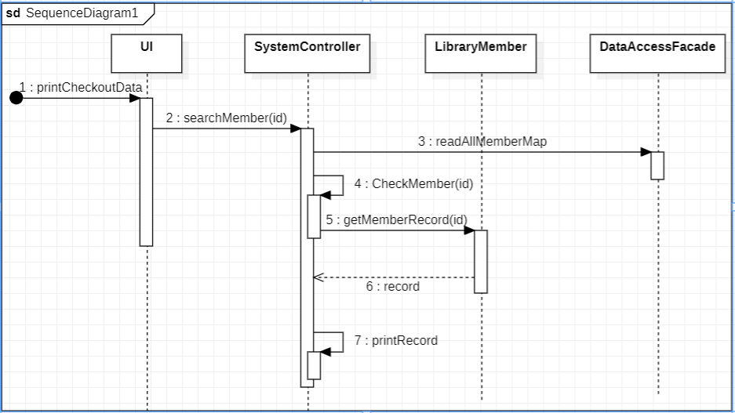
Print member checkout

Slide 10
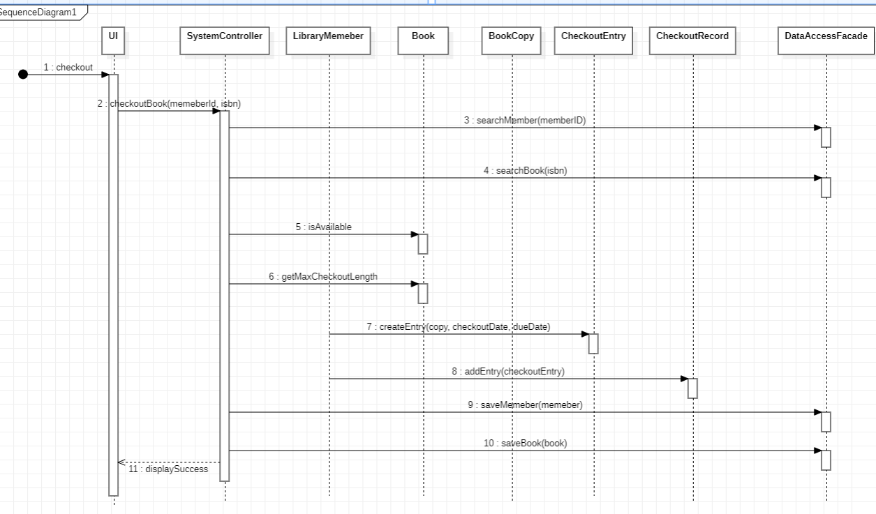
Checkout a book

Slide 11
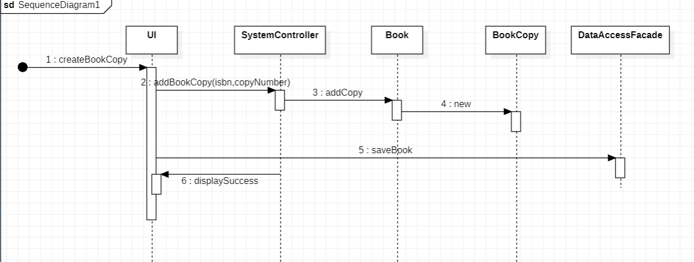
Add a book copy

Slide 12
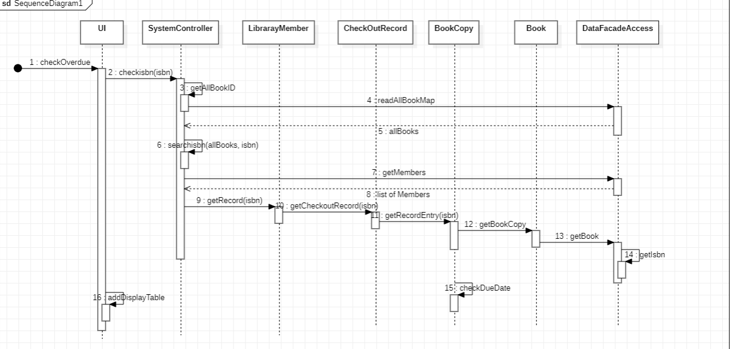
overdue

Slide 13
Thank you!!!

